Slide 1
Presentation brief for MCT’s
Title of presentation | Understanding LUIS
Presentation length | 90 minutes.
Audience | Azure AI Engineers, Azure Developers.
Purpose | Introduce LUIS Understand how to Create a LUIS Service in Azure Understand key LUIS concepts like Intents and Utterances
(think) Student key takeaways | The student should understand what LUIS is The student should understand how to create a LUIS service in Azure The student should have a grasp of the concepts of intents, utterances, and entities
(feel) Student desired mindset | The student should understand how to use LUIS to provide natural language understanding for an AI application
(do) Student outcomes | The student should be able to create a LUIS service The student should be able to create intents, utterances, and entities in their LUIS service
More information | For course feedback, please use the MCT forums

Slide 2

AI-100T01A Module 06: Integrate Cognitive Services with Bots and Agents

Slide 3
Agenda
Understanding Cognitive Services for Bot Interactions
Sentiment Analysis
Language Detection
Integrate Computer Vision

Slide 4










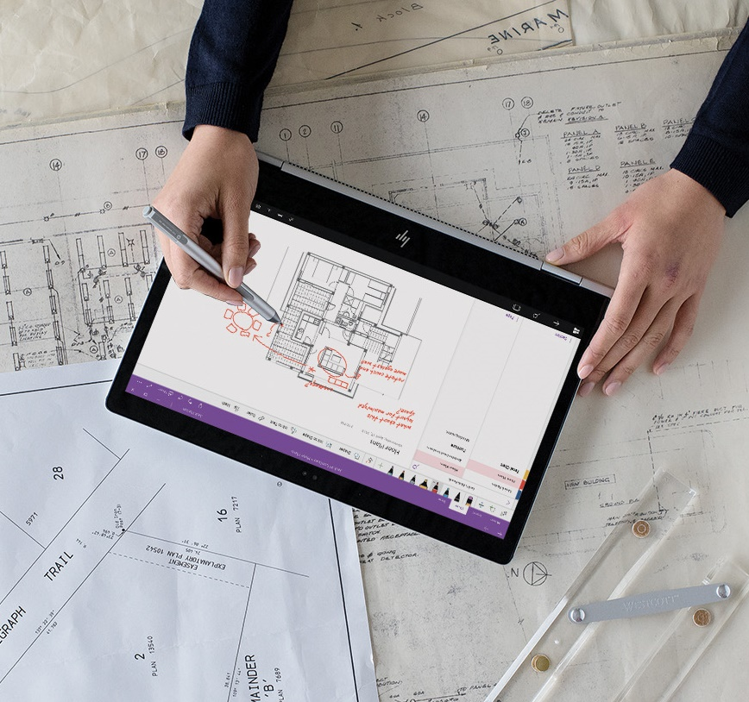


Lesson 01
Understanding Cognitive Services for Bot Interactions
Data
Cloud
AI

Slide 5
Lesson Objectives
L01 – Introduction
L02 – Bots and Text
L03 – Bots and Speech
L04 – Bots and Images

Slide 6
Introduction
Creating a great user experience with bots or agents
goes a long way to increasing user satisfaction and in a customer support scenario
can help with developing a good rapport with your customers.
As the course has taught, in the context of bots, the underlying intelligence, or AI, for your bot, is a primary responsibility of the bot creator.

Slide 7
Bots and Text
Having a user type text into a bot is one way that a bot interacts with users
Sentiment Analysis - text analytics APIs can help your bot determine sentiment in a conversation with the user.
Language Detection - use language detection and then translation services to communicate with the user in their native language.
Language Understanding - integrate your bot with LUIS

Slide 8
Bots and Speech
Utilizing speech services with a bot are not covered in this course but it's good to know that the option is there. One scenario uses the Azure speech service and your application to integrate with a bot in the following manner:
- accept the spoken audio
- convert that audio to text
- send the text to the bot for processing
- get the returned text from the bot
- convert it to speech using the speech services
- have the app speak it back to the user

Slide 9
Bots and Images
An insurance provider might decide to implement a "claims bot" that integrates with the Azure Computer Vision services.
User interacts with the bot by snapping a picture of the scene and the damage to the vehicle.
The bot sends the image to the computer vision service which could utilize image comparisons or even custom vision models to determine a cost estimate and perhaps a recommended repair center.
Perhaps even determine if the damage is significant enough that they should dispatch a tow truck to recover the vehicle and have it delivered to the appropriate repair shop.

Slide 10
Lesson 02
Sentiment for Bots with Text Analytics
Data
Cloud
AI

Slide 11
Lesson Objectives
L01 – Sentiment Analysis
L02- Guided Walkthrough – Test Sentiment Analysis

Slide 12
Sentiment Analysis Review
This API returns a sentiment score between 0 and 1 for each document, where 1 is the most positive.
The analysis models are pretrained using an extensive body of text and natural language technologies from Microsoft.
For selected languages, the API can analyze and score any raw text that you provide, directly returning results to the calling application.

Slide 13
Walkthrough – Test Sentiment Analysis

Slide 14
Lesson 03
Detecting Language in a Bot
Data
Cloud
AI

Slide 15
Lesson Objectives
L01 – Introducing Language Detection
L02 – Guided Walkthrough, Test Language Detection

Slide 16
Introducing Language Detection
The Language Detection API evaluates text input and for each document and returns language identifiers with a score indicating the strength of the analysis. Text Analytics recognizes up to 120 languages.

Slide 17
Example Request and Response
{
"documents": [
{
"id": "1",
"detectedLanguages": [
{
"name": "English",
"iso6391Name": "en",
"score": 1
}
]
},
{
"id": "2",
"detectedLanguages": [
{
"name": "Spanish",
"iso6391Name": "es",
"score": 1
}
]
},
{
"id": "3",
"detectedLanguages": [
{
"name": "French",
"iso6391Name": "fr",
"score": 1
}
]
…
{
"documents": [
{
"id": "1",
"text": "This document is in English."
},
{
"id": "2",
"text": "Este documento está en inglés."
},
{
"id": "3",
"text": "Ce document est en anglais."
},
…

Slide 18
Walkthrough – Test Language Detection

Slide 19

Lab 8: Language Detection in a Bot

Slide 20
Lab Objectives
Implement Language Detection with a Bot

Slide 21
Lab Scenario
Users may interact with your bot in their native language. Your bot should provide for this scenario and react by either changing the language used for responses or simply indicate that their entered language is not supported. Either way, you will need to determine which language the user is entering initially.

Slide 22

Next steps
Module Summary
In this module, you have learned about:
Cognitive Services integration with Bots
Sentiment Analysis
Testing Language Detection
After the course, consider exploring how to use some of the other cognitive services in a Bot. Some ideas would be to look at using speech translation, which is a powerful way to interact with users.

